Slide 1
Sport Finance Training
2020-21

Slide 2
Contents
Topic
Introduction to SU Finance
Your ‘account’
What piece of paper do I need? (payments)
Processing Finance Forms
Finance Codes
Authorisation Limits
VAT for Sports Clubs
Fundraising

Slide 3
Introduction to SU Finance
Where are we?
Students Union Finance Office
Level 3 Student Centre
10am-3pm Mon-Fri (Term)
01225 385061/386613
sufinance@bath.ac.uk
www.thesubath.com/finance
Services
Payments – Bank transfer, Cheques, Credit Card, Foreign Transfers and Petty Cash
Income – In person, invoicing and online sales
Purchase Orders
Cash boxes and floats
Club Ledgers
University Print and Catering Orders
Transfers to University Depts
Pre paid Euro Travel Card
Cash and Carry Account
What is the Students’ Union?
A Registered Charity
Separate Entity to the University
Subject to University internal audit, annual external audit & HMRC VAT Inspection
Has a Board of Trustees and SU Governance
Funded through a block grant & Commercial income

Slide 4
What you need to get started!
You need to have completed your handover documents (Budget request is done last year)
Then when you come back in October you should have:
You should have an email from the Sport Officer with your ‘club budget’
You should have an email from the Sport Officer confirming any ‘rolled over’ from the previous year
If applicable, you will have an email from the sport officer confirming any ‘BUCS Performance Plan’ funding that you will receive
Any further funding that you have gained will need to be confirmed (sponsorship deals must be agreed by the Sport officer)
You need to have read and understand all of the above documents and asked any questions about things that are unclear to you.

Slide 5
Your ‘account’
Each group is given it’s own “finance account” within the SU. It’s not quite the same as a regular bank account, but it keeps your money safe and separate from other groups.
ALL MONETARY TRANSACTIONS RELATED TO CLUB ACTIVITIES MUST GO THROUGH THE SU!
Your Department Code:
Your money is collected under a 3 letter department code which keeps it separate from everyone else’s. For example, the department code for American Football is AMF. Every time an American Football player buys a product from thesubath.com, or spends money on new equipment the money is collected under this code so the SU knows who it belongs to.
These accounts are in place to prevent committee members from having to spend their own money on society goods and should anything bad ever happen, your money is protected under the SU.

Slide 6
Your ‘account’
Ledgers
These are basically a list of all the transactions that happen in your account. Credit is money in, Debit is money out. Slightly confusingly when you see your ledger, NEGATIVE numbers are money that have come INTO your account and POSITIVE numbers is money OUT
These are emailed to your club email accounts each week. You can also get an up to date ledger from the finance office, these look a little different to the ones that are emailed to you though so should only be use for checking individual transactions
General Tips
Items are split by Expense Type and each payment has a unique reference number.
Each Expense Type has its own total. Credit is money paid into the account. Debit is money paid out of the account.
You can request a ledger either in person at the Finance Office or by email.
At the bottom of the ledger there will be a Credit total and a Debit Total. Subtracting the Debit from the Credit will give the account total.
You should finish the year on with the same total for debits and credits.

Slide 7
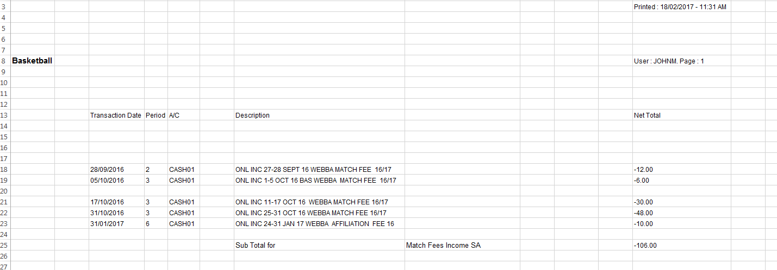
Your ‘account’
Example Ledger
Date of Transaction
Description of Transaction
Money in
Money out

Slide 8
Your ‘account’
At the start of the year your club budget and any rollover money from the previous year will be credited to your account.
This means that you must finish the year with a ZERO BALANCE on you Club account.
This has changed since last year so please be aware of this.

Slide 9
Your ‘account’
Keeping Records
We would recommend that you keep record of the transactions that you sign off.
A simple method of doing this is simply to keep a spreadsheet of, date, description and amount for each transaction. You can then check they appear on your account when it gets emailed to you.

Slide 10
What piece of paper do I need?
All payments in the SU are dealt with by using finance forms. Yellow, Orange, Blue or an invoice, for each of them you will need some sort of piece of paper.

Slide 11
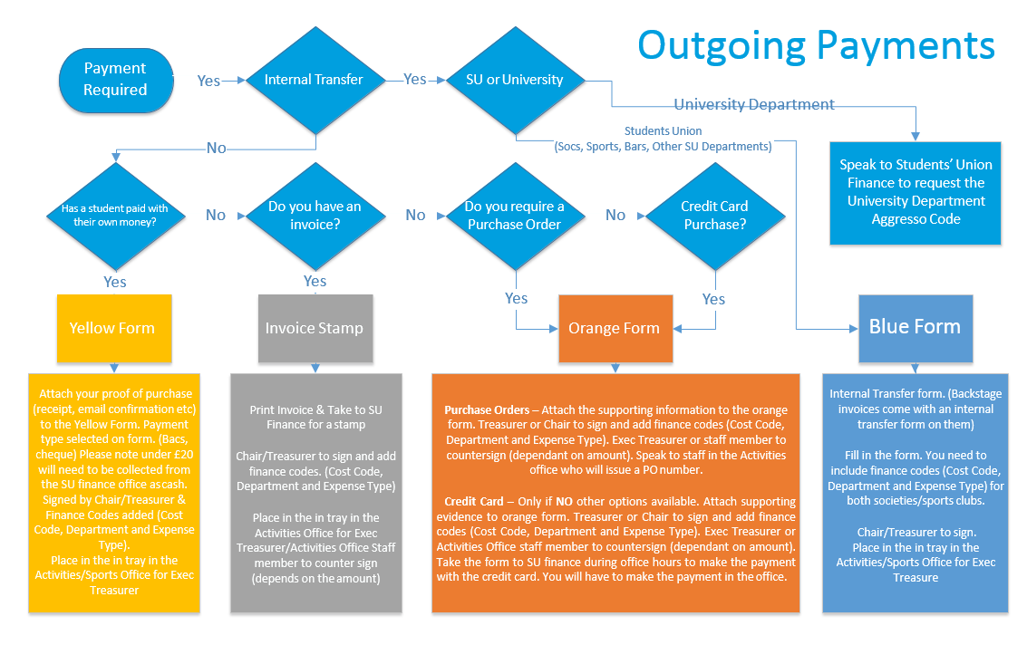
What piece of paper do I need?
Outgoing Payments

Slide 12
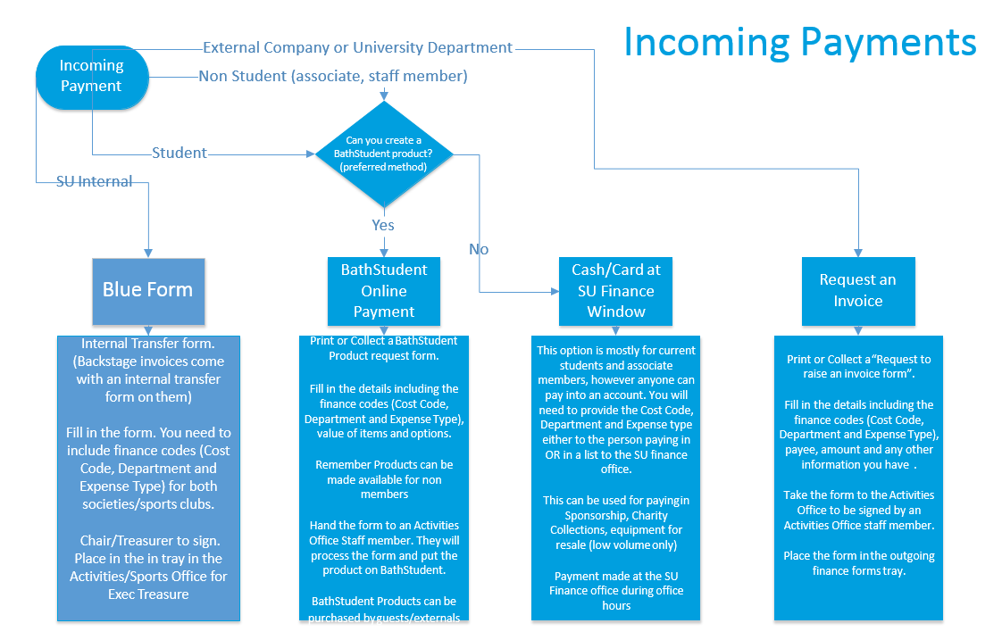
What piece of paper do I need?
Incoming Payments

Slide 13
Processing Finance Forms
Where can I find a form?
Either at the finance office, the finance webpage, (thesubath.com/finance) or The Sport Office.
What do I need to fill out a form?
Cost code - always SAS (unless this is money for a charity see fundraising section)
Department Code – This is your unique club code (eg. BAS Basketball) (see next page for all clubs)
Expense Type – This is a code that groups types of expenditure (eg. 52210 – entry fees) (see two pages over for all codes)

Slide 14
Processing Finance Forms
Correctly filling in a form
Correctly fill in the cost code, department, and expense type.
Get the Chair or Treasurer to sign the form. Only they can do this
Double check all details are correct. Remember you can’t authorise a payment to yourself!
Bring the form to the Sport Office and put it in the ‘Sport In Tray’
The Sport Exec Treasurers will then counter sign
This process can take up to two weeks so give yourself plenty of time when planning activities.

Slide 15
Processing Finance Forms
Dealing with an invoice
Sometime a company will give you an invoice for a product or service. These are dealt with slightly differently.
Take the invoice to the finance office they will stamp and sign it.
Correctly fill in the cost code, department, and expense type.
Get the Chair or Treasurer to sign the invoice. Only they can do this.
Double check all details are correct. Remember you can’t authorise a payment to yourself!
Bring the invoice to the Sport Office and put it in the ‘Sport In Tray’
The Sport Exec Treasurers will then counter sign
This process can take up to two weeks so give yourself plenty of time when planning activities.

Slide 16
Sport Club Department Codes
AMF | American Football |  | LAT | Latin and Ballroom
ARC | Archery |  | MOT | Motorsports
ASF | Association Football & Futsal |  | MOU | Mountaineering
ATH | Athletics |  | NET | Netball
BAD | Badminton |  | RID | Riding
BAS | Basketball |  | ROU | Rounders
BOX | Boxing |  | ROW | Rowing
CAN | Canoe Club |  | RUG | Rugby
CHE | Cheerleading |  | SHO | Shooting
CRI | Cricket |  | SKY | Skydiving
CUE | Cue Sports |  | SLN | Sailing
CYC | Cycling |  | SNO | Snowsports
DOD | Dodgeball |  | SQU | Squash
FEN | Fencing |  | SUR | Surf
GLI | Gliding |  | SWI | Swimming
GOL | Golf |  | TAB | Table Tennis
GYM | Gymnastics |  | TAE | Taekwondo
HAN | Handball |  | TEN | Tennis
HOC | Hockey |  | TRA | Trampolining
JIT | Jiu Jitsu |  | TRI | Triathlon
JUD | Judo |  | ULT | Ultimate Frisbee
KAR | Karate |  | VOL | Volleyball
KIC | Kickboxing |  | WEI | Weightlifting
LAC | Lacrosse |  | WPO | Water Polo
 |  |  | WSU | Windsurfing

Slide 17
Sport Club Expense/Income Codes
Income Codes |  |  | Expense Codes
53005 | Membership Income SA |  | 73005 | Affiliation Fees SA
53010 | Competition/Entry Income SA |  | 73010 | Competition/Entry Fees SA
53015 | Activities Income SA |  | 73015 | Activities Costs SA
53020 | Accomodation Income SA |  | 73020 | Accomodation Costs SA
53025 | Training Income SA |  | 73025 | Training Costs SA
53030 | Transport Income SA |  | 73030 | Transport Costs SA
53035 | Equipment Income SA |  | 73035 | Equipment Purchase SA
53040 | Merchandise Income SA |  | 73040 | Merchandise Resale SA
53045 | Socials Income SA |  | 73045 | Socials Costs SA
53050 | Fundraising Income SA |  | 73046 | Admin Costs SA
53055 | Sponsorship Income SA |  | 73047 | Officials Costs SA

Slide 18
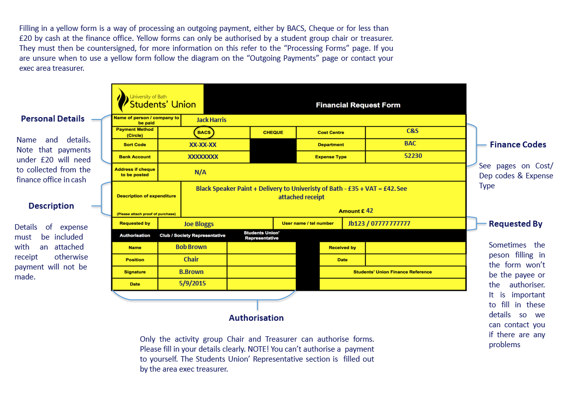
Yellow Forms

Slide 19
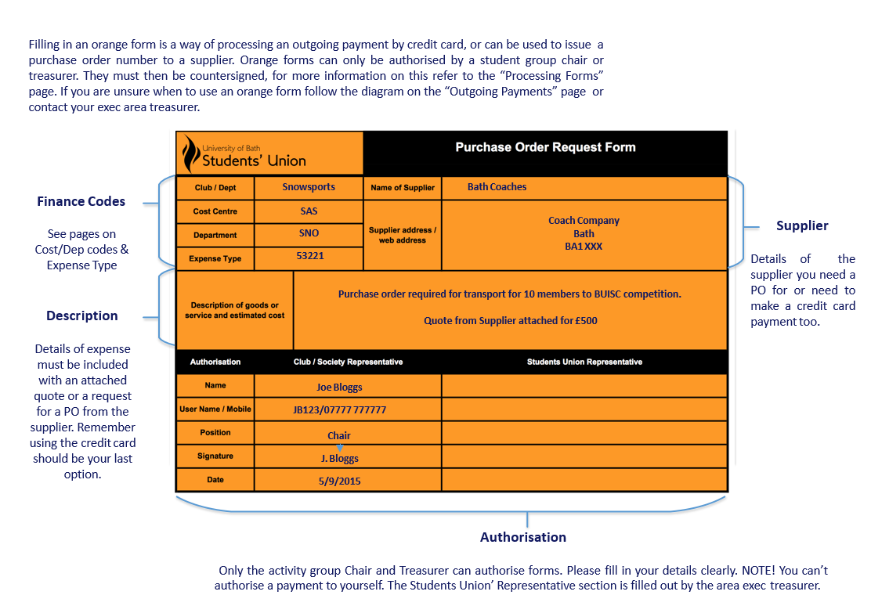
Yellow Forms
4SP

Slide 20
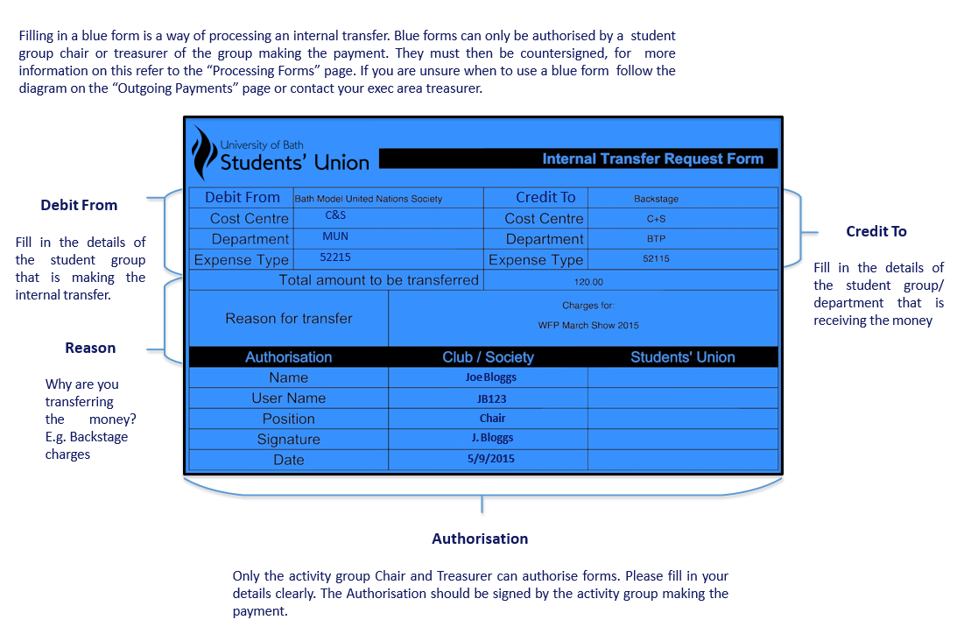
Blue Form

Slide 21
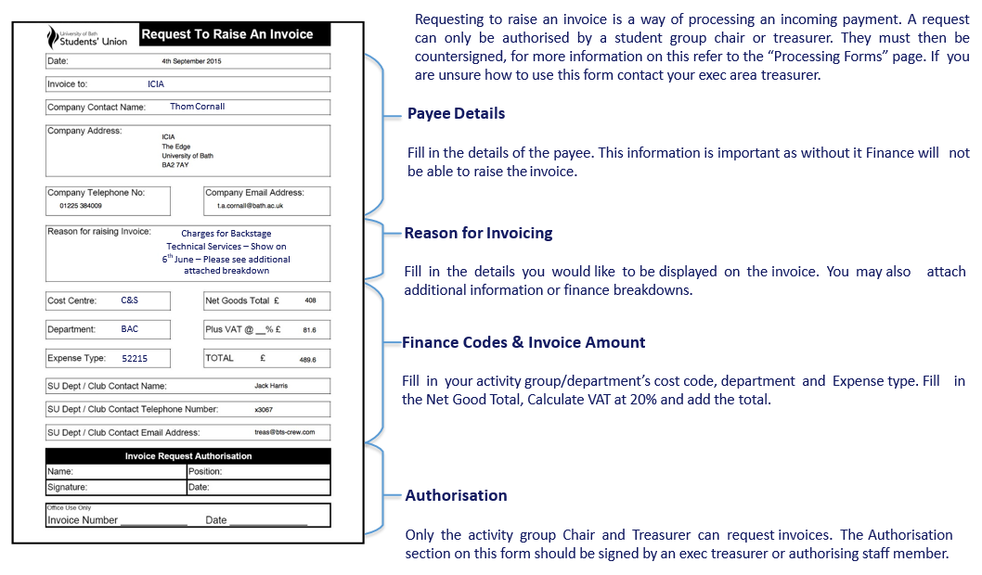
Invoice Request Form

Slide 22
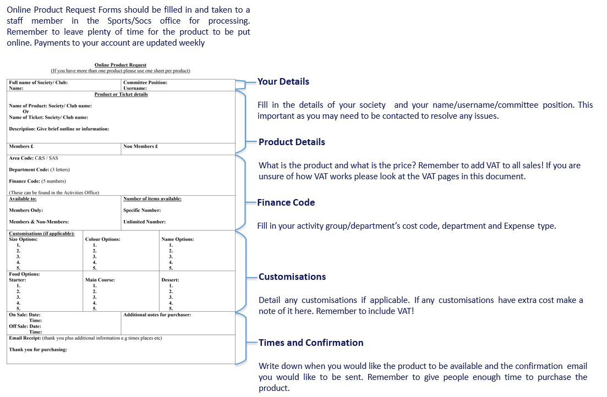
Online Product Request Form
4SP

Slide 23
Printing and Catering
When using the University print service (IDPS) or ordering catering, such as for an event in the Calverton Rooms you should ask for a quote for the cost. Once you have done this attach it to an orange form to request a purchase order. A PO is a promise to pay with a reference number. It is important that you follow this procedure and get you quote approved by a staff member before you go ahead.

Slide 24
Cash Floats
A float is a sum of cash loaned to you with a cash tin to enable you to sell tickets/products on campus. To requires a cash float a tallow form should be completed with CASH FLOAT written on the top. This can be signed by the activities office. Bring the signed for to the Finance Office and they will issue the float to you in the denominations that you require. After your sales are complete you return the tin and float to the finance office and bank the savings into the club account.

Slide 25
Authorisation Limits
These are the people that need to sign off forms depending on the amounts
Order Value | People to sign
Up to £500 | Student Group Chair or Treasurer | Area Co-ordinator or Sport Exec Treasurer
Up to £1000 | Student Group Chair or Treasurer | Exec treasurer
Up to £1500 | Student Group Chair or Treasurer | Sport Officer or Activities Manager
Over £1500 | Student Group Chair or Treasurer | Sport Officer and Finance Director

Slide 26
VAT for Sports Clubs
What is VAT?
VAT (Value added tax), is a form of taxation raised by the government, collected by companies (i.e. The Students Union) on behalf of the government. You must have a VAT receipt/Invoice with the VAT number of the company otherwise you will always be charged the gross amount.
Sport Clubs are exempt from VAT on all payments EXCEPT socials and equipment for re-sale. This doesn’t mean you don’t pay VAT, it just means that it is accounted for differently.
Basically, for all payments on exempt items, the club account shows income and expenditure including VAT. For Socials and Equipment for resale all income and expenditure is show excluding VAT
VAT is probably the biggest source of confusion for clubs so please ask at the finance office if you are unsure.

Slide 27
VAT for Sports Clubs
Example for Social/Equipment for resale:
You are organising a meal for your members the total cost is £12 per person and there are 20 people going:
You set up an online product for £12 (£10 + £2 VAT)
20 people purchase it
For each purchase you see £10 in your club ledger, the £2 extra goes into a ‘VAT pot’, so total income in the club account is £200
You get an VAT invoice from the company for £240 with £40 of that being VAT
When you pay the invoice, the club account will show an expenditure of £200 the other £40 come back out of the ‘VAT pot’

Slide 28
VAT for Sports Clubs
Example for everything else:
You are charging for tickets to a rugby event:
You set up an online product for £20
20 people purchase it producing £400
For each purchase you see £20 in your club ledger
You get an VAT invoice from the company for £400
When you pay the invoice, the club account will show an expenditure of £400

Slide 29
Fundraising
As an affiliated group of the Students’ Union which is a charity, you are entitled to raise money for yourselves.
If you are raising money for your group you do not need to do anything special, income from the fundraising event can go straight into your club account.
If you are raising money for an external Charity you cannot use your club account.
As a charity in our own right the Students’ Union cannot donate it’s own funds to charity, if you are planning a fundraising event you must use different cost codes and details to ensure that the money makes it’s way to the right place.
Please speak with Anna Boneham <A.Boneham@bath.ac.uk>

